Slide 1
Statistics 367-1-4361 Model Comparison
Opher Donchin

Slide 2
10.1 Overfitting and underfitting
A first criterion for choosing between models

Slide 3
Often many models are possible
Choosing predictors
Continuous and categorical
Interactions
Hierarchical structure
Heteroscedasticity
Transformations
Likelihood choices
Robust likelihoods
Bounded likelihoods

Slide 4
So far we have only one type of comparison
Null hypothesis testing
Reject specific models
Because they are not probable a posteriori
Because they are not likely to produce our data
Or accept a null model
If HDI is in ROPE
We want to compare models
Not just reject or accept them

Slide 5
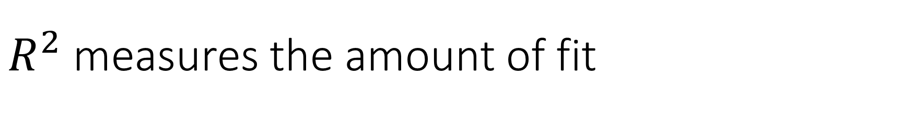
$R^{2}$ measures the amount of fit
How much of the total variance is explained by the model
Often called ‘goodness of fit’
Always goes up with the number of parameters
Is the model with the highest ‘goodness of fit’ the best model?

Slide 6
Occam’s razor is about useful simplicity
A model with more parameter can fit more complex data
Maybe fits real structure in the world
Maybe a model is just fitting noise
When two models have the same fit
Prefer the simple one
Chatton’s anti-razor
Contemporary disputant of William of Ockham
If three assumptions are not enough to explain the phenomena
A fourth will be necessary

Slide 7
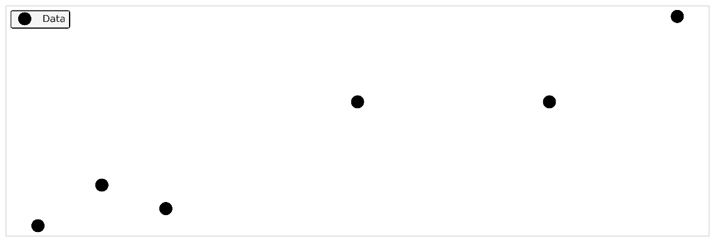
We want to model some data

Slide 8
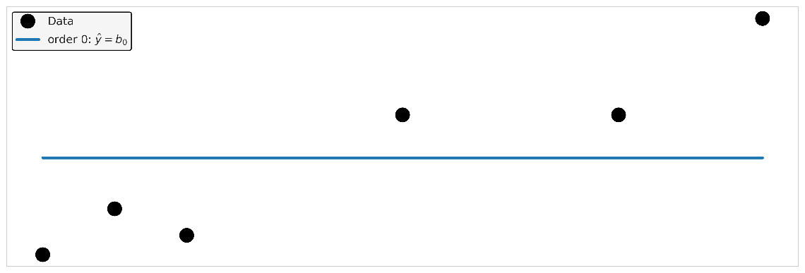
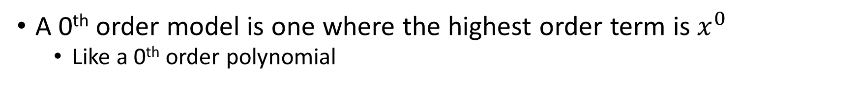
A model that underfits
A 0th order model is one where the highest order term is $x^{0}$
Like a 0th order polynomial

Slide 9
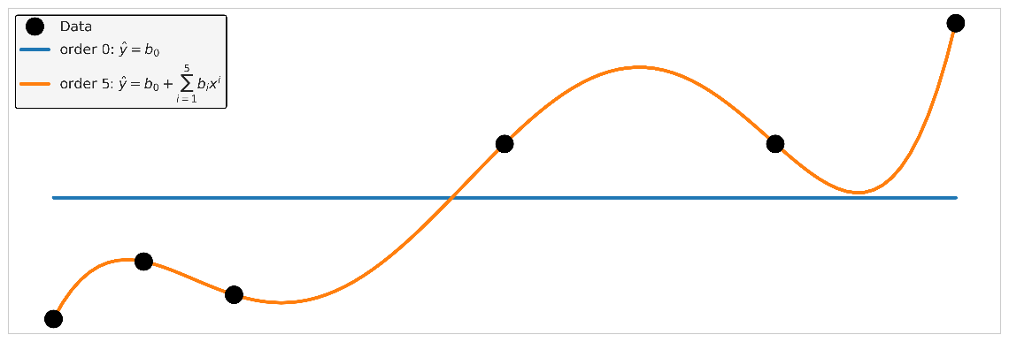
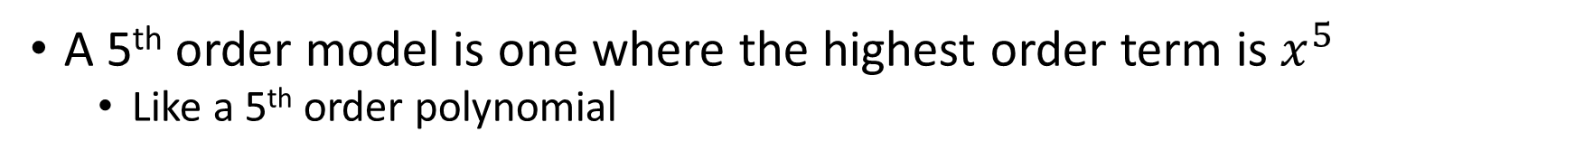
A model that overfits
A 5th order model is one where the highest order term is $x^{5}$
Like a 5th order polynomial

Slide 10
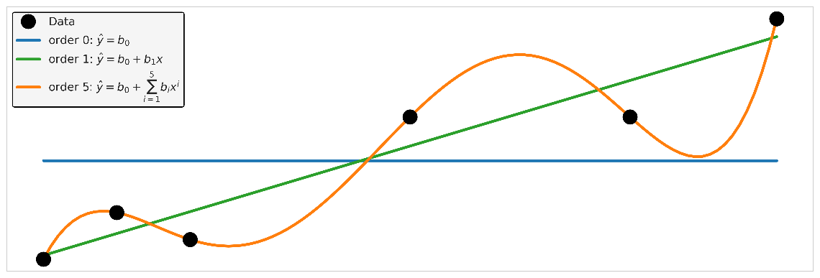
We want a model that balances overfitting and underfitting

Slide 11
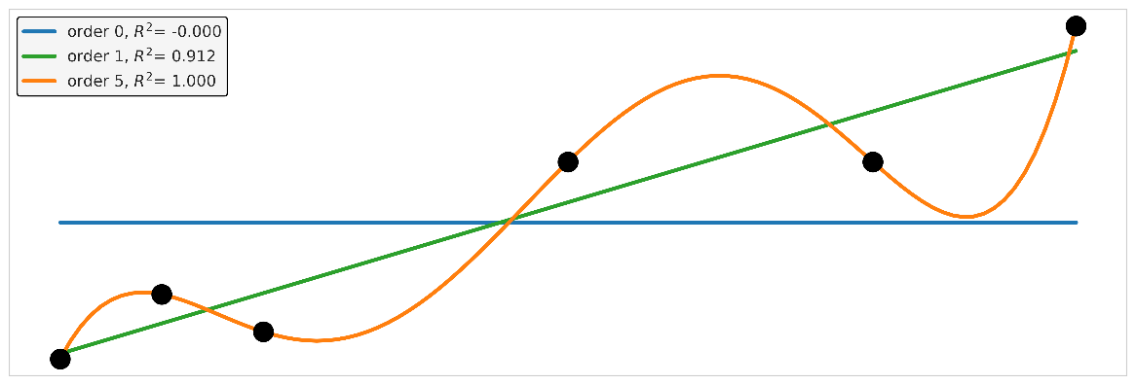
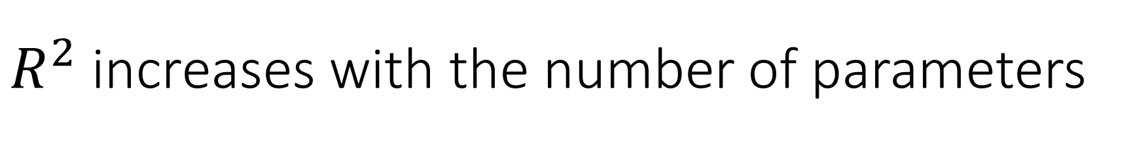
$R^{2}$ increases with the number of parameters

Slide 12
How well should a model fit?
A model that is too simple is like a prior that is too strong
Choice of model determines results
The data doesn’t speak
A model that is too complex is like a prior that is too weak
Noise in the data overwhelms structure
Model choice is just as important as prior choice
Like prior choice, it can be done right

Slide 13
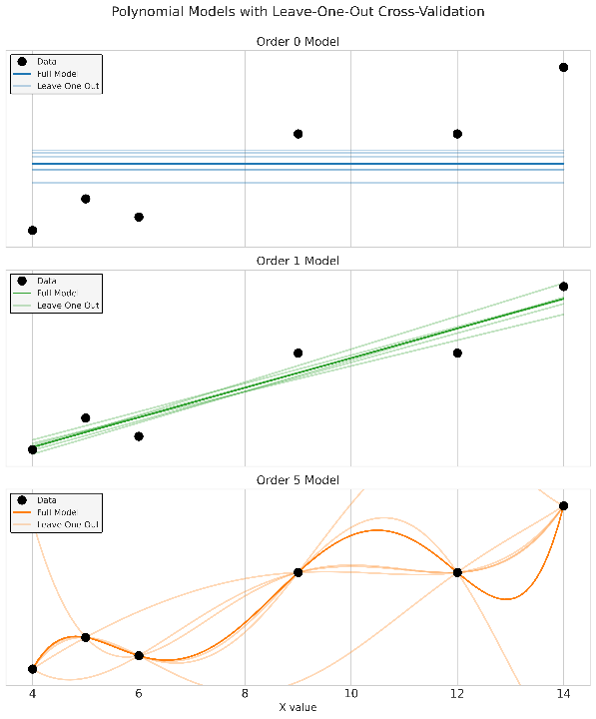
Leaving out one data point
Overfit model
Overly sensitive to data details
Underfit model
Ignores important details
In real model comparison
This is a key method

Slide 14
10.2 What makes a good model
Different scientific goals imply different comparison tools

Slide 15
All models are wrong
A perfect model would be as complex as reality
Useful models simplify reality
The question is not whether a model is true
The question is whether it is useful for the goal
“All models are wrong, but some are useful.”

Slide 16

Some models are useful
So what can they be useful for?
Hypothesis testing
Prediction
Theory building
Different uses, different goals

Slide 17

Theory building
Models underlie our understanding
Especially scientific understanding
Reflect important truths about reality
Better models reflect important parts
More faithfully
A good model must be:
Interpretable
Meaningful
Generalizable
Science is: accepting good enough models

Slide 18
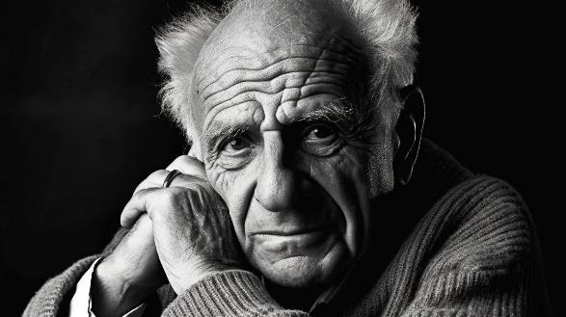
Hypothesis testing
Karl Popper The Logic of Scientific Discovery 1934
Scientific theories can’t be proven, but only falsified
Practically this lead to:
Progress through falsifying simplistic theories
Statistical tests to reject simple theories
No different / no effect / no influence
Science is: rejecting bad models

Slide 19
Prediction
Up until the 1970s
Focus on finding ‘true’ parameter values
Focus on hypothesis testing
1970s: The link through information theory
Find the model ‘closest’ to the true model
Notice connection to predictive accuracy
1980s: The prediction revolution
Mervyn Stone 1983
A.P. Dawid 1984
Under the best model, future data is likely
Science is: comparing candidate models

Slide 20
Model comparison depends on the goal
Goal | Good model means | Tools
Theory building | Interpretable and meaningful | posterior contrasts, effect sizes
Hypothesis testing | Rules out a simple model | ROPE/HDI, Bayes factor
Prediction | Predicts new data well | Tools of model comparison we will learn today

Slide 21
10.3 Kullback-Liebler Divergence
Models that are closer to being the true model predict better

Slide 22
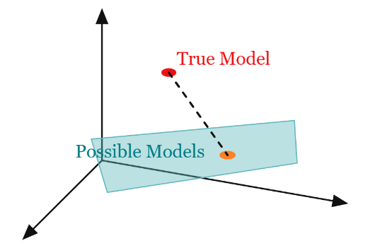
We do not have the true model
Hypothesis testing assumes one model might be true
Either the null model is true or an alternative
But we know that all models are false
Maybe the best model is the one closest to the truth

Slide 23
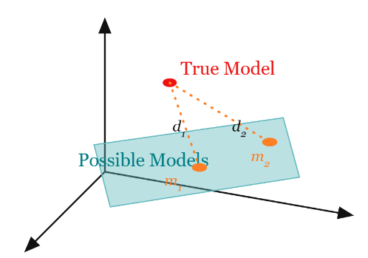
A distance measure might help
A distance measure might
Give the distance from the true model
Allow comparison between models
Can we measure distance from the true model?
By using new data
New data comes from the true model

Slide 24
A measure of distance between models
The Kullback-Leibler divergence
The added “entropy” from using the wrong distribution
The cross entropy minus the entropy

Slide 25
Surprise connects probability and prediction
Three concepts of entropy
The number of possible states
The uncertainty about the state
The information from learning the state
For all three: the entropy of two separate systems should be additive

Slide 26
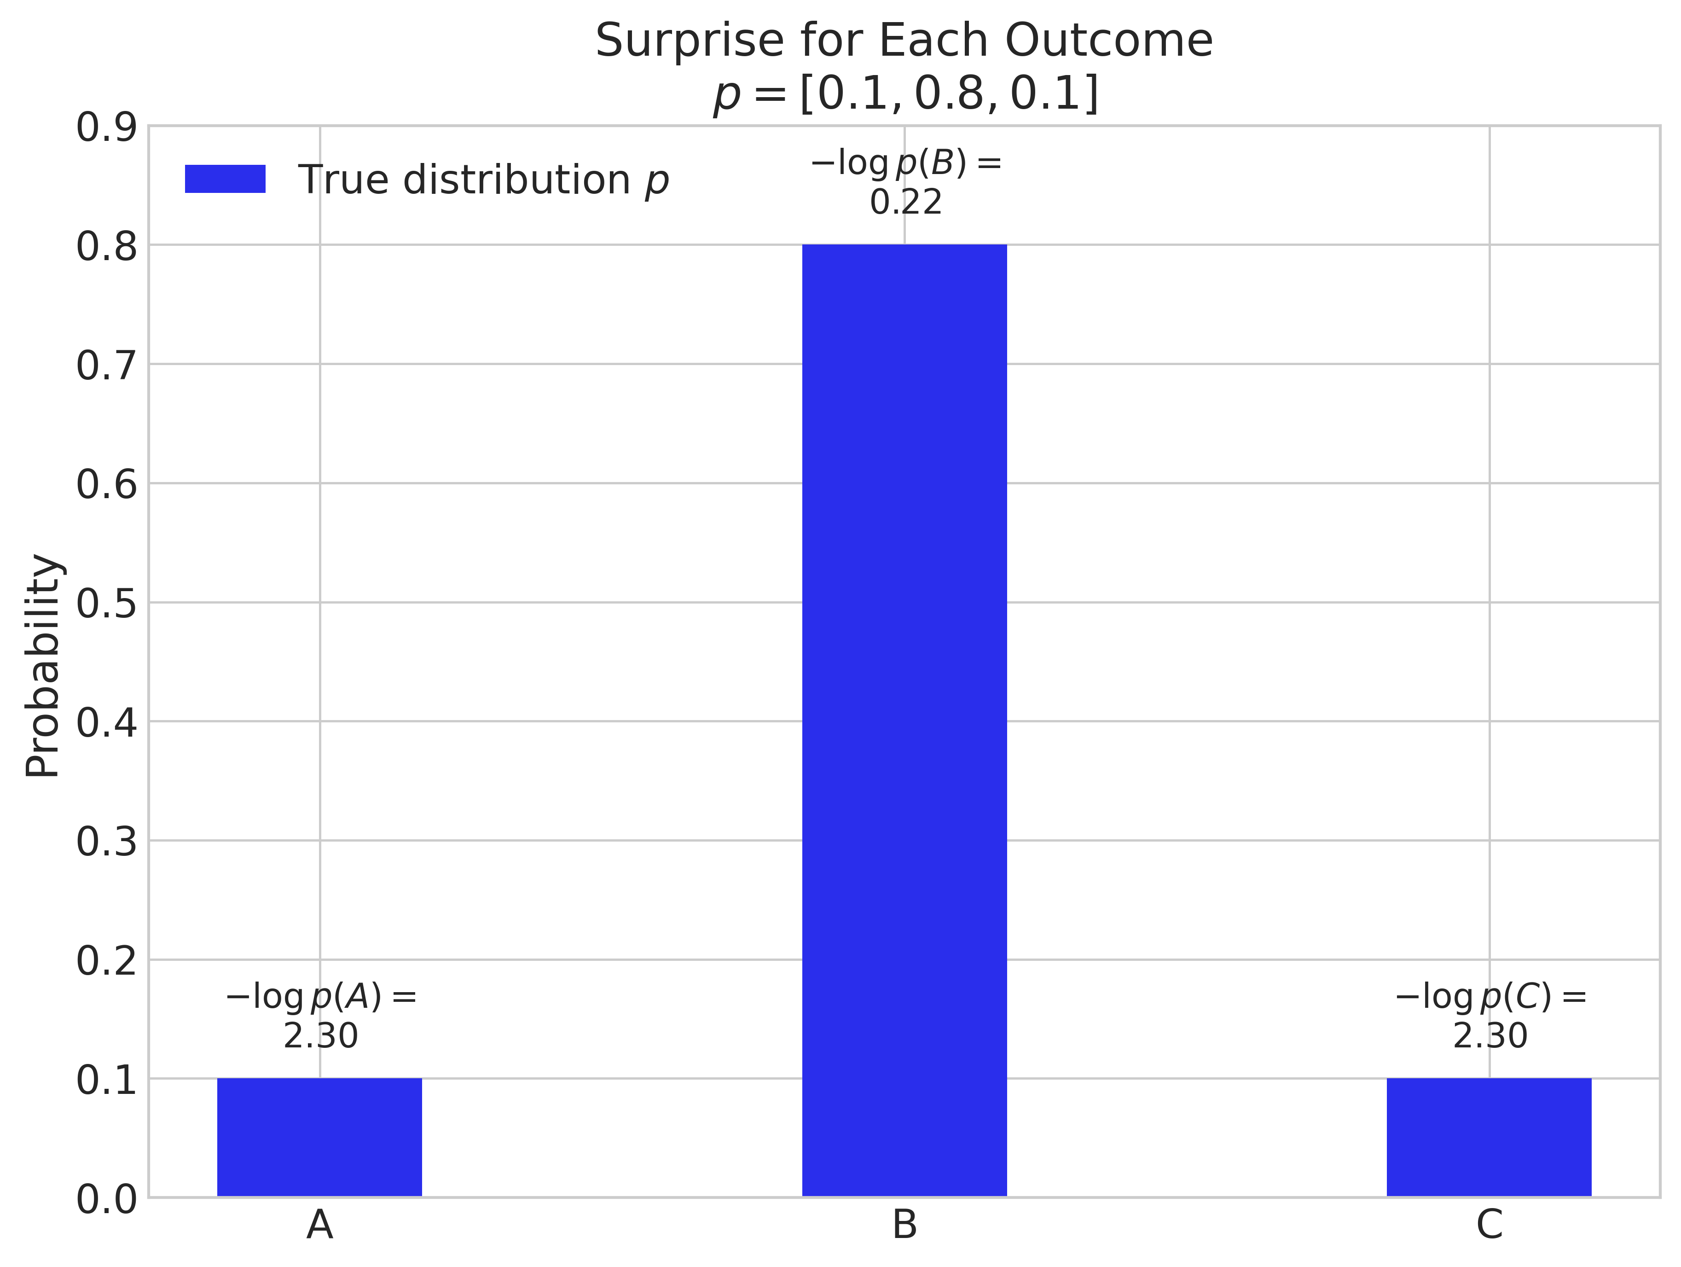
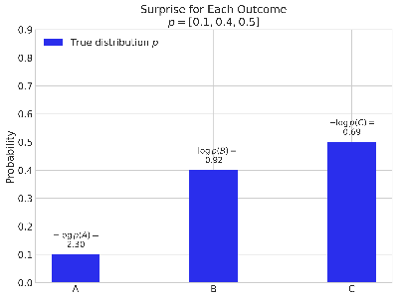
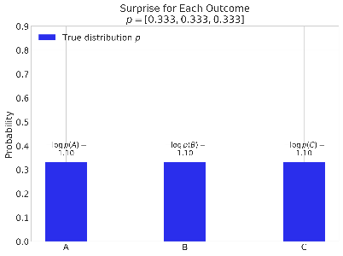
Entropy is a measure of how predictable reality is
If we make a guess according to probability
How likely are we to be correct?

Slide 27
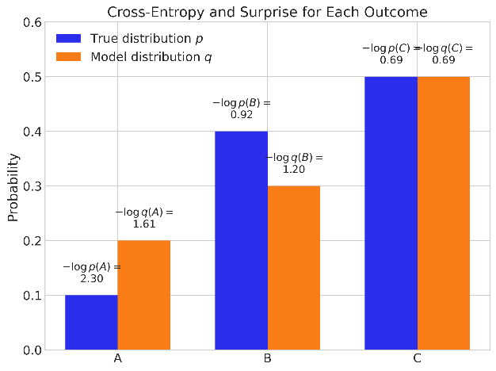
Cross-entropy is surprise for wrong guesses
The cross-entropy is always larger than the entropy
Being wrong means being more surprised

Slide 28
KL divergence measures extra surprise
The difference between the cross entropy and the entropy
The added uncertainty of using the wrong model
An (asymmetric) measure of distance between two distributions
Insert definitions
Rearrange terms
Combine integrals
The average (over the true distribution) of how wrong we are (in units of surprise)

Slide 29
In our case: the model from the truth
The distance of the model’s distribution from the true data distribution
The true likelihood vs the posterior predictive likelihood
Here $y$ means the probability density of data, not the specific data we collected.

Slide 30
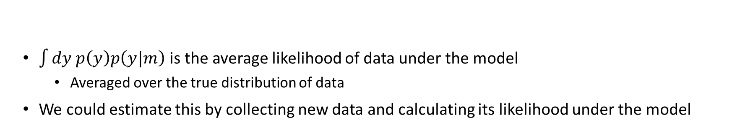
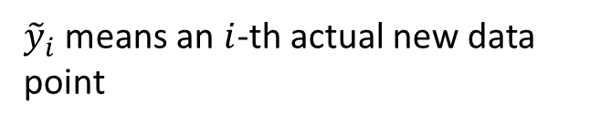
The score
$\int{dy p\left(y\right)p\left(y|m\right)}$ is the average likelihood of data under the model
Averaged over the true distribution of data
We could estimate this by collecting new data and calculating its likelihood under the model
${\tilde{y}}_{i}$ means an $i$-th actual new data point
The score

Slide 31
Calculating the score
To find likelihood of new data under the model
Average over the posterior distribution under the model
Often people calculate deviance instead of score
Different units, same idea

Slide 32
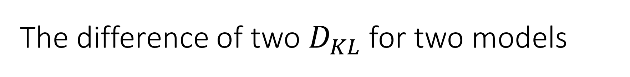
The difference of two $D_{KL}$ for two models
Is the difference of their scores!

Slide 33
To compare models we calculate the score
Each score is meaningless, only the comparison matters
Cannot be actually calculated on existing data
Intuitively: how wrong a model is about what the real world is like (the KL divergence from reality) can be characterized by the likelihood it associates with new data.
Up to a constant factor

Slide 34
10.4 Information criteria
Methods for approximating the score without getting new data

Slide 35
Information criteria estimate out-of-sample prediction
We want expected predictive accuracy on new data
We only have the observed data
Our predictive accuracy is always better on observed data than new data
Information criteria estimate the optimism from fitting and testing on the same data
Different criteria estimate this correction differently
One approximation is that our optimism is measured by how quickly the log likelihood changes with $θ$

Slide 36
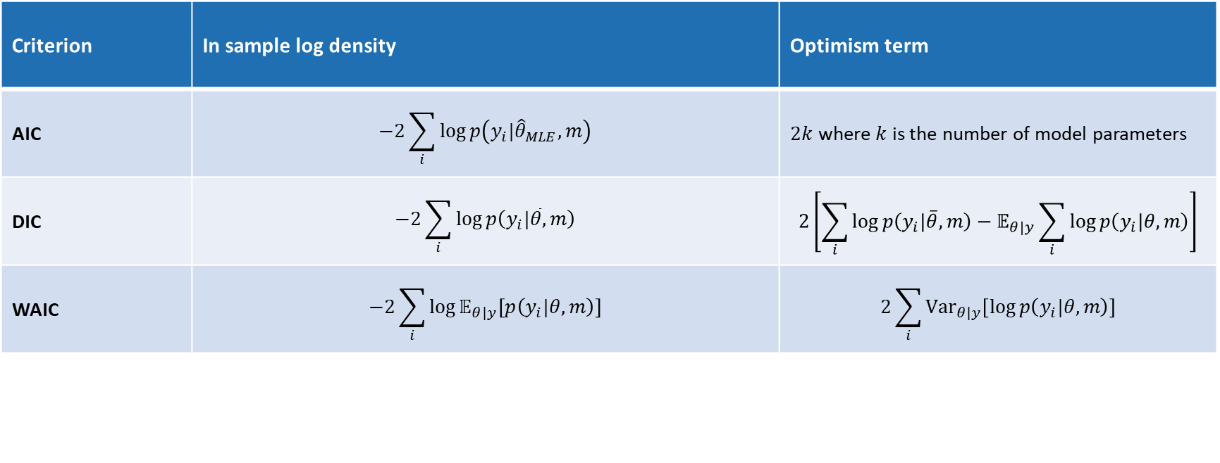
Several criteria estimate predictive accuracy
Criterion | In sample log density | Optimism term
AIC | $$−2\sum_{i}{\log{p\left(y_{i}|{\hat{θ}}_{MLE},m\right)}}$$ | $2k$ where $k$ is the number of model parameters
DIC | $$−2\sum_{i}{\log{p\left(y_{i}|\overline{θ},m\right)}}$$ | $$2\left[\sum_{i}{\log{p\left(y_{i}|\overline{θ},m\right)}}−𝔼_{θ|y}\sum_{i}{\log{p\left(y_{i}|θ,m\right)}}\right]$$
WAIC | $$−2\sum_{i}{\log{𝔼_{θ|y}\left[p\left(y_{i}|θ,m\right)\right]}}$$ | $$2\sum_{i}{{Var}_{θ|y}\left[\log{p\left(y_{i}|θ,m\right)}\right]}$$

Slide 37


AIC is the Frequentist information criterion
$$AIC=−2log p\left(y|\hat{θ},m\right)+2k$$
$−2log p\left(y|θ,m\right)$: Smaller when model has good fit to observed data $2k$: Smaller for simpler models
$k$ is the number of parameters
Lower AIC is better

Slide 38
AIC has limitations
Uses a point estimate of in sample likelihood
Neglects uncertainty
Uses parameter counting
The number of parameters measures model complexity
Proportional to variance for linear regression models
But assumes:
Parameters are not correlated
Parameters are all regression coefficients
Model is not hierarchical or otherwise structures

Slide 39
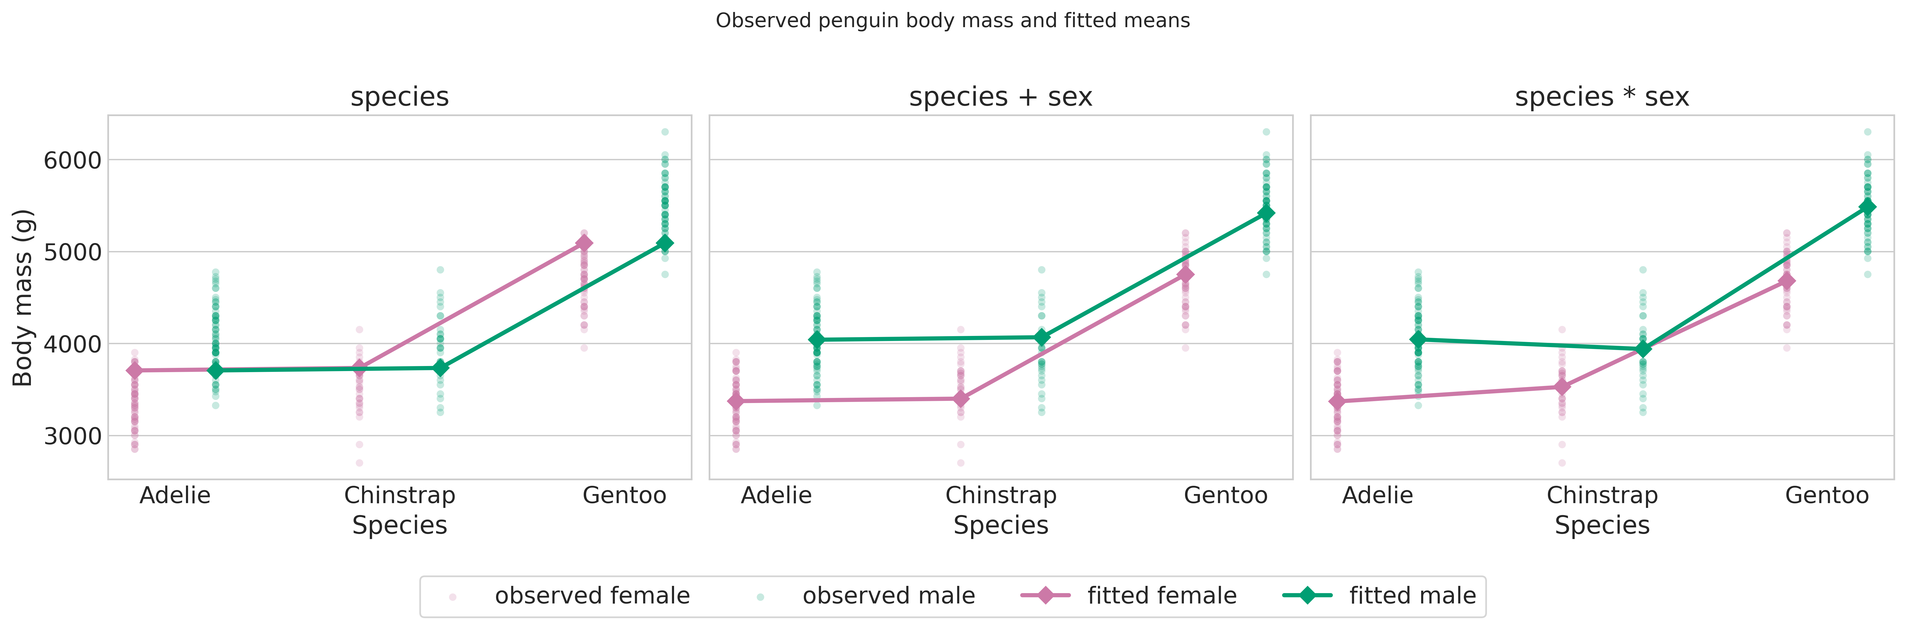
Comparing different models
Fit 3 models to the penguin bodyweight data

Slide 40
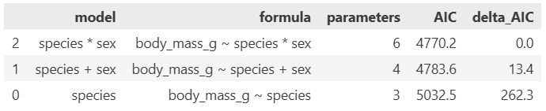
AIC in an applied model comparison
Compare candidate regression or ANOVA models Smaller AIC means better estimated predictive performance Differences matter more than absolute values
smf.ols(formula, data=penguins_model_df).fit()
ols_fit.aic

Slide 41
WAIC is a Bayesian information criterion
Uses the full posterior to estimate the score
Accounts for parameter uncertainty for in sample likelihood
Uses the shape of the posterior directly to estimate optimism

Slide 42
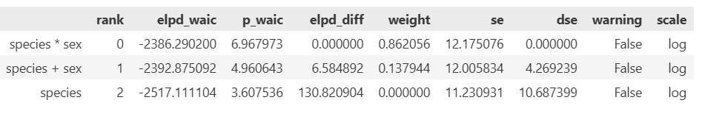
WAIC in an applied model comparison
WAIC table gives estimate uncertainty
‘Best’ model may not be much better
WAIC model also shows test for influential data points
If one data point is overly influential, WAIC is biased estimate of score
az.compare(penguin_idata, ic="waic")
p_waic estimates the model complexity (the number of effective parameters)
weight can be used to get improved predictions by using a weighted combination of models
dse is the standard error of the difference
Warning means that there are influential points

Slide 43
Predictive power is not the only criterion
Three different criteria for a good model
Building theories
Testing hypotheses
Predicting the future
When evaluating models, we should consider all three:
Does it have predictive power?
Does it inform us about our scientific hypotheses?
Does it give us information about meaningful parameters?
In different situations, these may have different importance?

Slide 44
10.5 Cross-validation
Testing prediction by fitting to part of the data and testing on the other part

Slide 45
WAIC is only an estimate of true validation
WAIC estimates the ability to predict new data
Testing the model on actual new data is called validation

Slide 46
Validation and cross-validation
Strategies for validation
True validation
Go out and collect a new data set
Withheld data
Divide data into train and test
Sometimes into train, test, and validate
Cross-validation
Train on subsets of data
Test on others
Repeat over subsets
True validation is expensive and time consuming
Withheld data is vulnerable to leakage
There is a bias variance tradeoff
Cross-validation requires multiple model fits

Slide 47
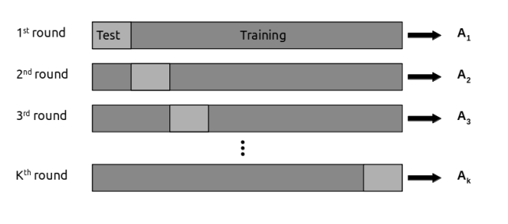
K-fold cross-validation
Divide the data into k chunks
For each chunk
Fit model to the rest of the chunks
Evaluate log likelihood on that chunk
Average predictive ability across chunks
Widely used in machine learning
Problematic in Bayesian analysis
Because fitting models is expensive

Slide 48
Leave-one-out cross-validation
Make N chunks of size 1
Approximate instead of refitting the model
Expected log predictive density

Slide 49
LOO-CV is an unbiased estimate of ELPD
Where WAIC corrects a biased estaimte

Slide 50
LOO is expensive if done literally
We are taking the integral over the wrong probability
This trick is called importance sampling
If we had
We would write
Now we have
So we can write

Slide 51
Importance sampling approximates LOO
This approximates the expected log likelihood of new data

Slide 52
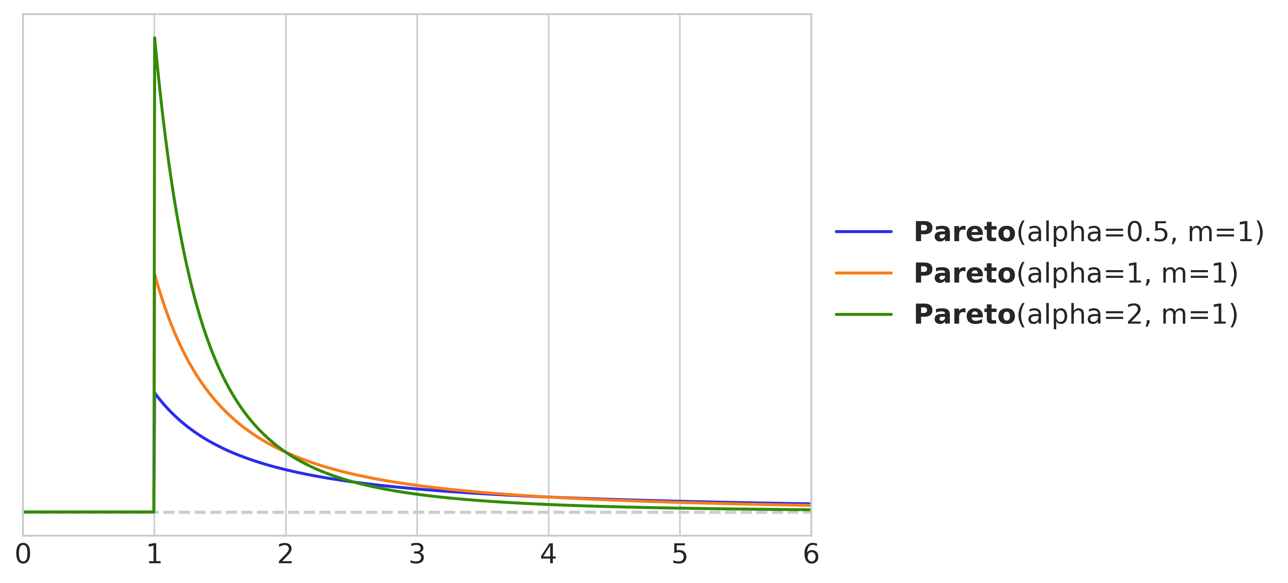
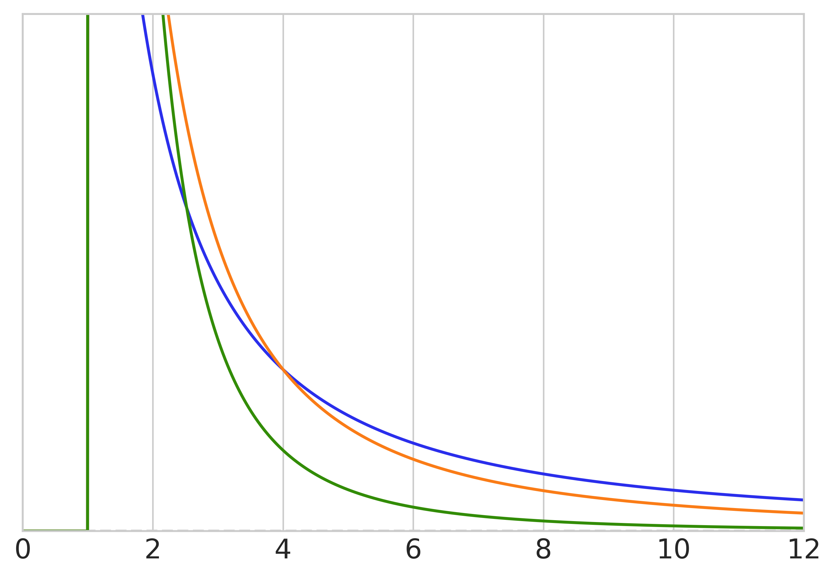
PSIS stabilizes the approximation
The Pareto distribution has wider tails
Like the Student’s t distribution
But much wider
Replace extreme weights (usually top 20%)
Using Pareto distribution fit to the rest of the weights
Unreliable if shape parameter > 1!

Slide 53
Pareto k is a diagnostic
In importance sampling
You sample the proposal distribution instead of the target distribution
And then weight the samples according to the ratio
This has a problem if the importance weight is too large

Slide 54
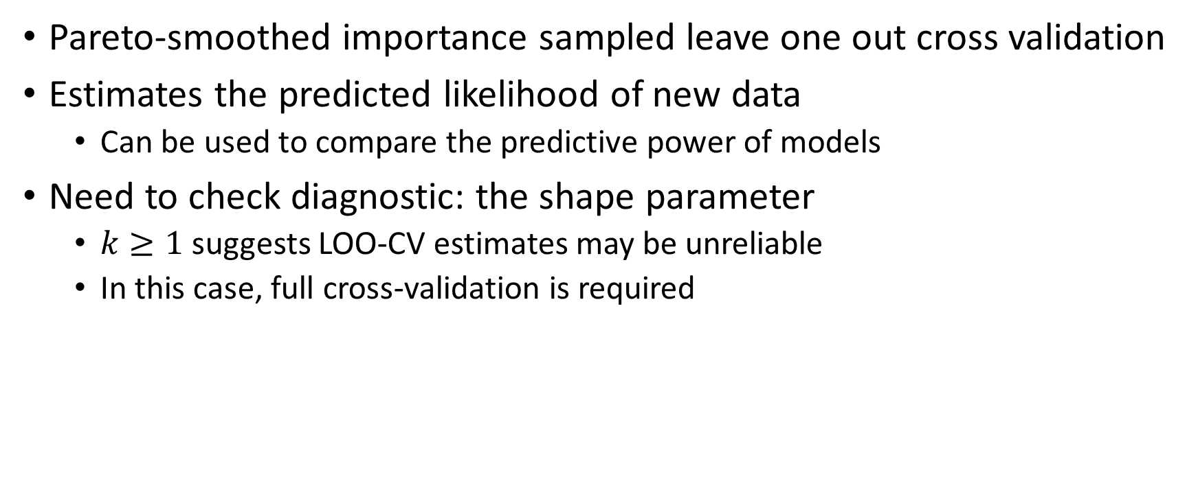
PSIS-LOO is usually our preferred comparison tool
Pareto-smoothed importance sampled leave one out cross validation
Estimates the predicted likelihood of new data
Can be used to compare the predictive power of models
Need to check diagnostic: the shape parameter
$k≥1$ suggests LOO-CV estimates may be unreliable
In this case, full cross-validation is required

Slide 55
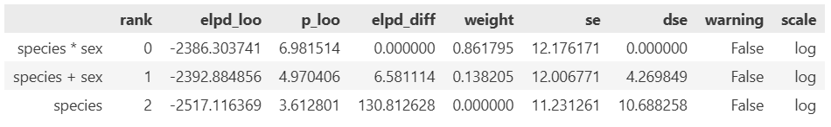
Comparing model comparison criteria
az.compare(penguin_idata, ic="loo")

Slide 56
Important caveats about predictive power measures
You cannot use them on models with different likelihoods
Changing the likelihood is like changing the scale of measurement
They apply to hierarchical models but not trivially
Are you predicting:
New observations with the same groups
New observations with different groups
New groups and not new observations
Influential observations or a large Pareto smoothing constant should not be ignored
More than one model may be viable
Sometimes differences are small
Sometimes a model can be preferred despite lower predictive power

Slide 57
10.6 Updated Bayesian workflow
Model comparison is one step in a larger analysis

Slide 58
Model comparison belongs inside the workflow
1 Scientific question 2 Candidate models 3 Prior predictive check 4 Sample 5 Diagnostics 6 Posterior predictive check 7 Compare predictive accuracy 8 Interpret model differences
Watch for
• Compare models that answer the scientific question • Never compare models before checking diagnostics • Predictive ranking usually doesn’t replace interpretation

Slide 59
Effect size and prediction answer different questions
Quantity | Question
R² | How much variance does the model explain?
partial R², η² | What does one term add?
Cohen's f | Effect size in residual-variance units
AIC / WAIC / LOO | Which model predicts new data better?
Effect size is about interpretation Predictive comparison is about expected future performance A model can have a meaningful effect but weak predictive advantage

Slide 60
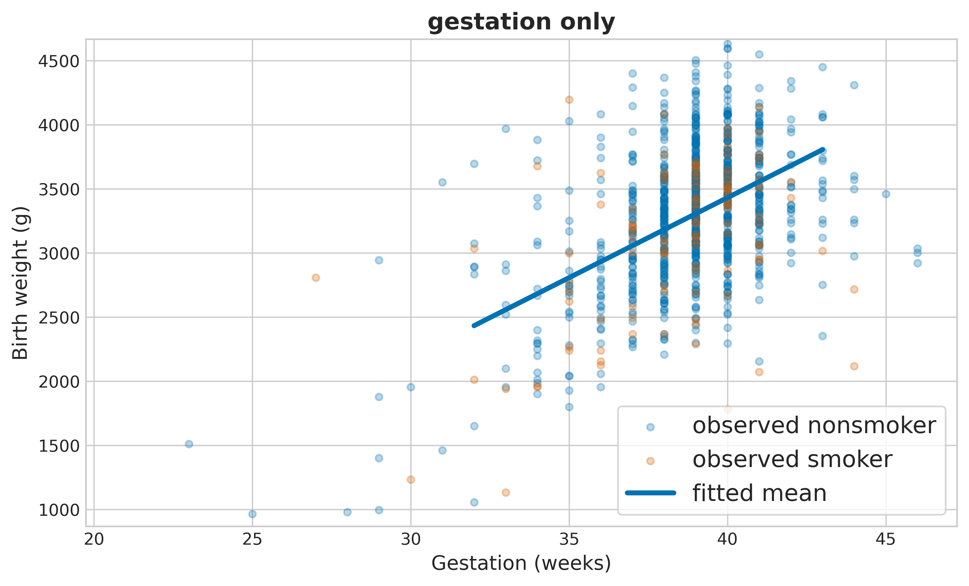
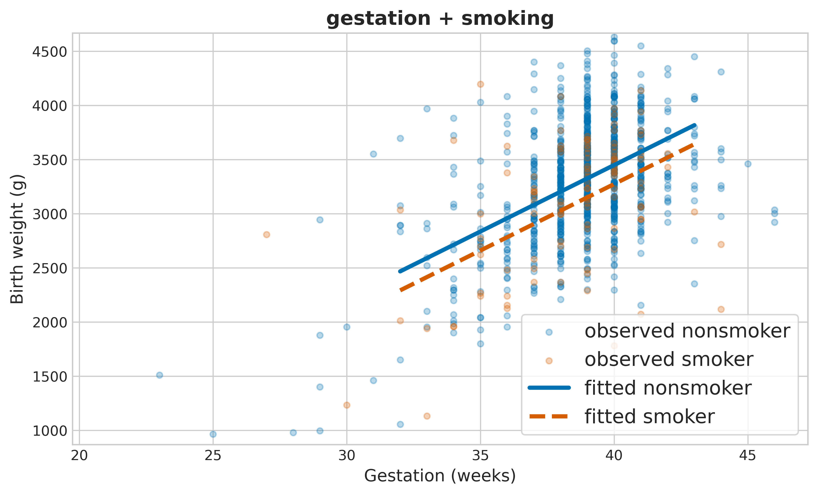
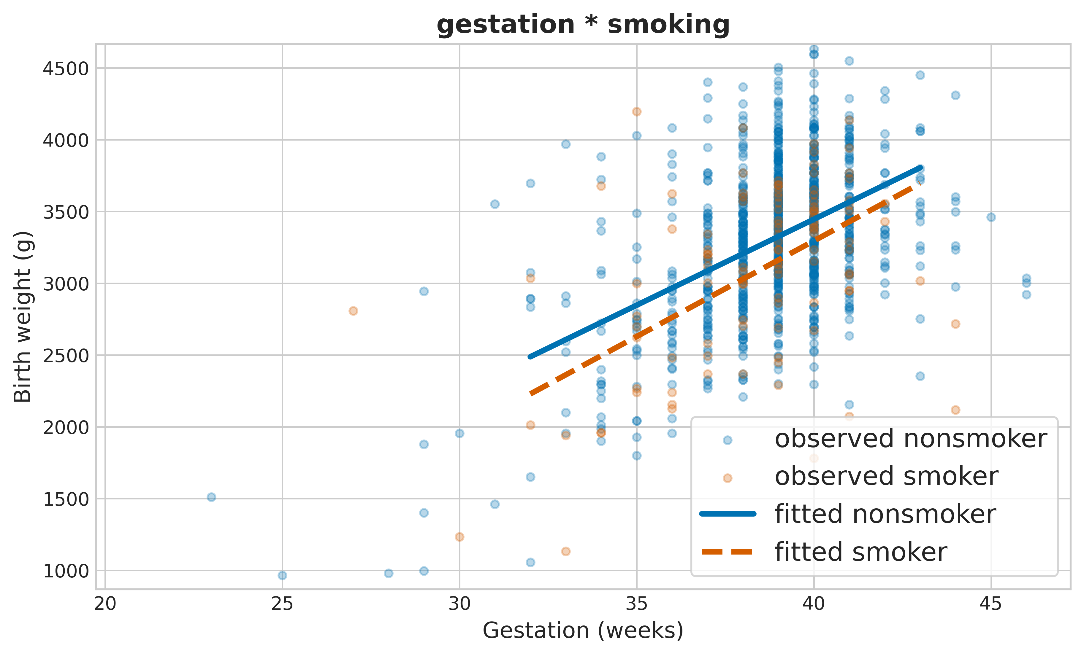
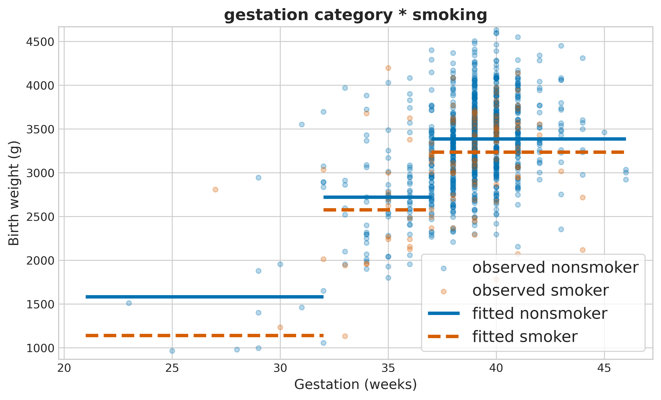
Returning to birth weight and gestation age
Looking at this with our new lens
What were the effects
What were the effect sizes
Which model has the best predictive power
Which model deepens our understanding

Slide 61
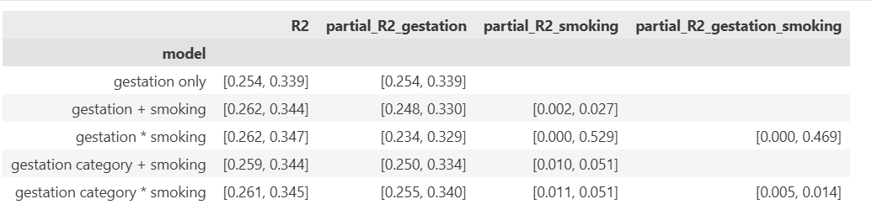
Effect sizes for the models and the factors
Effect sizes of smoking in the interaction model are largest

Slide 62
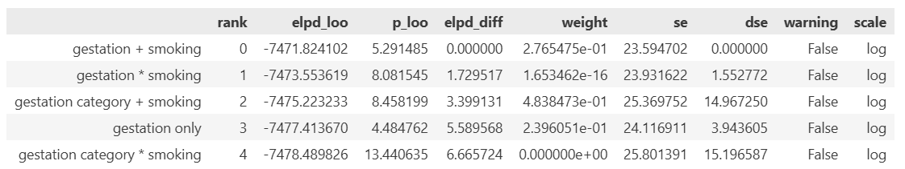
Model comparison
The standard error of all the differences is on the scale of the differences themselves

Slide 63
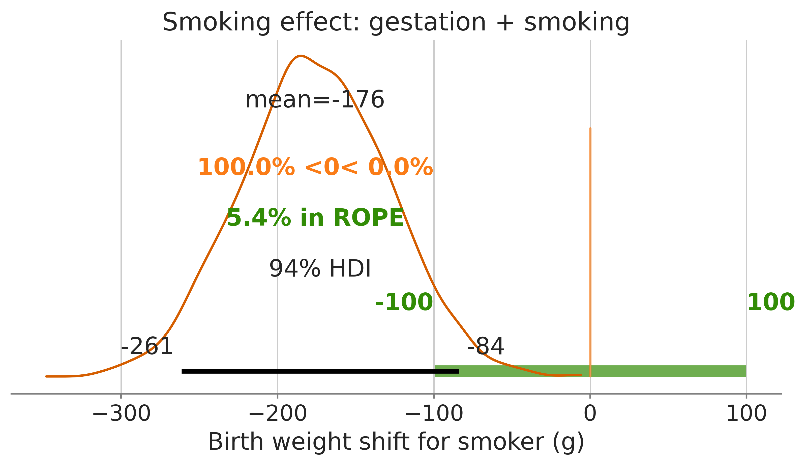
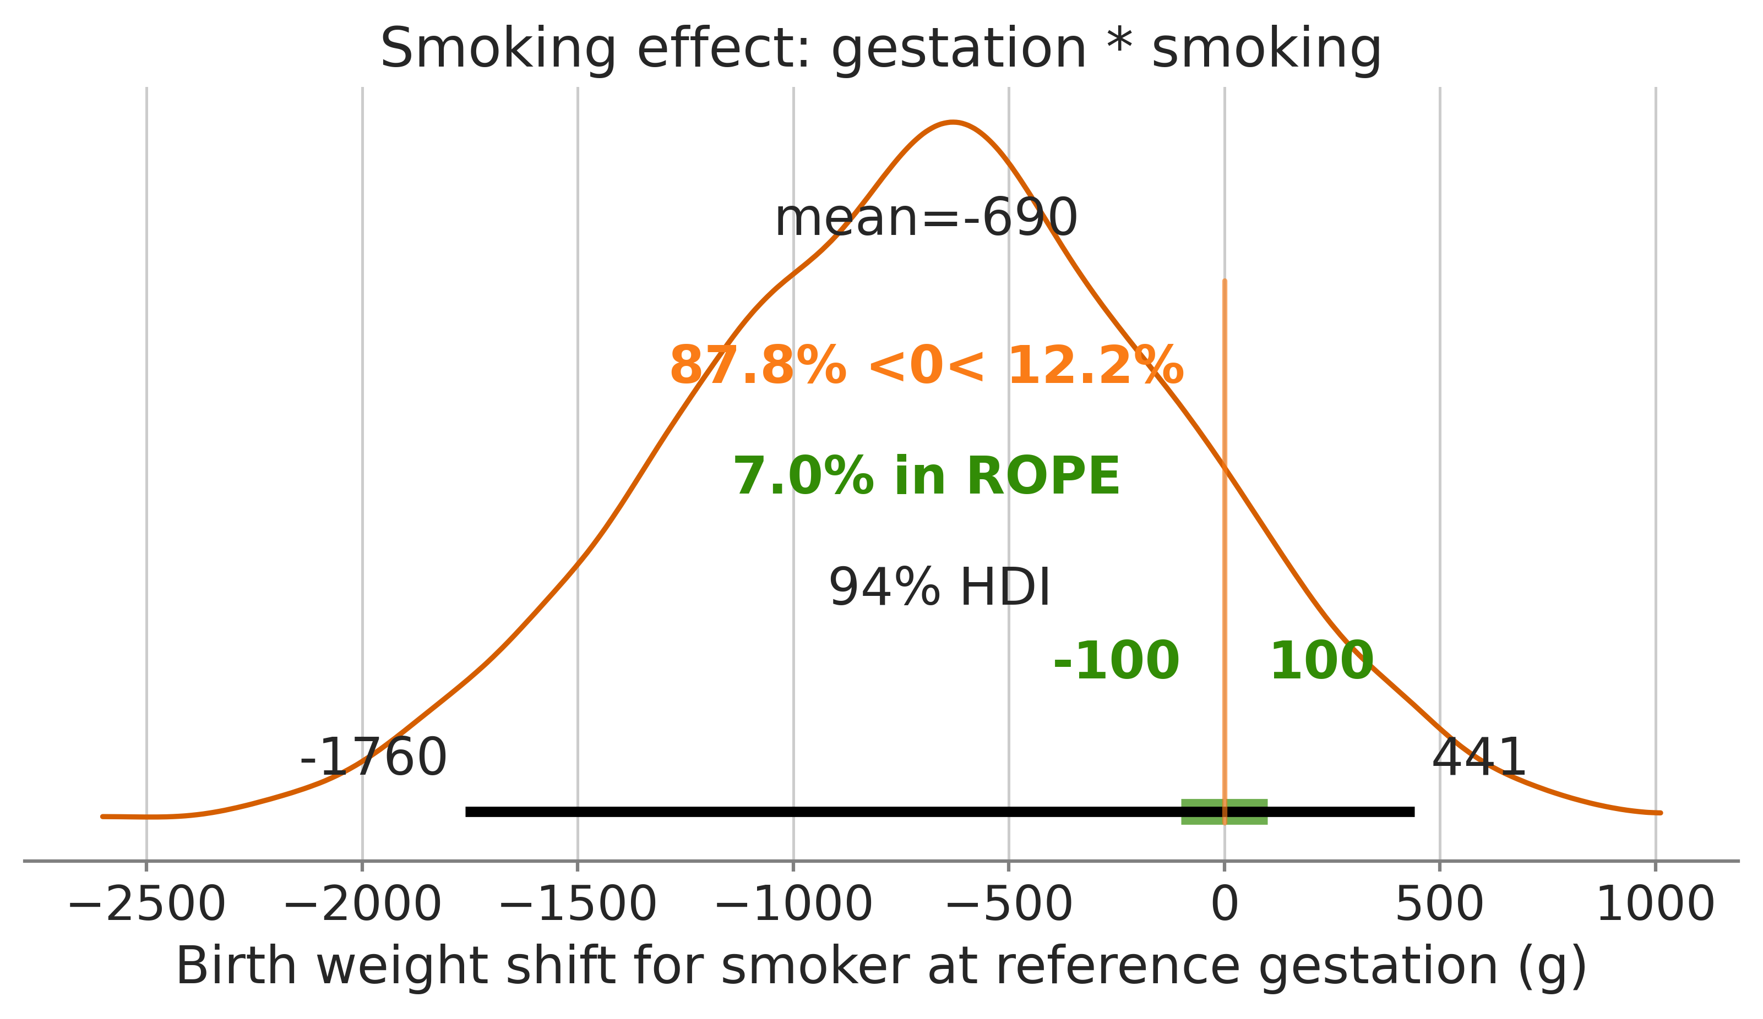
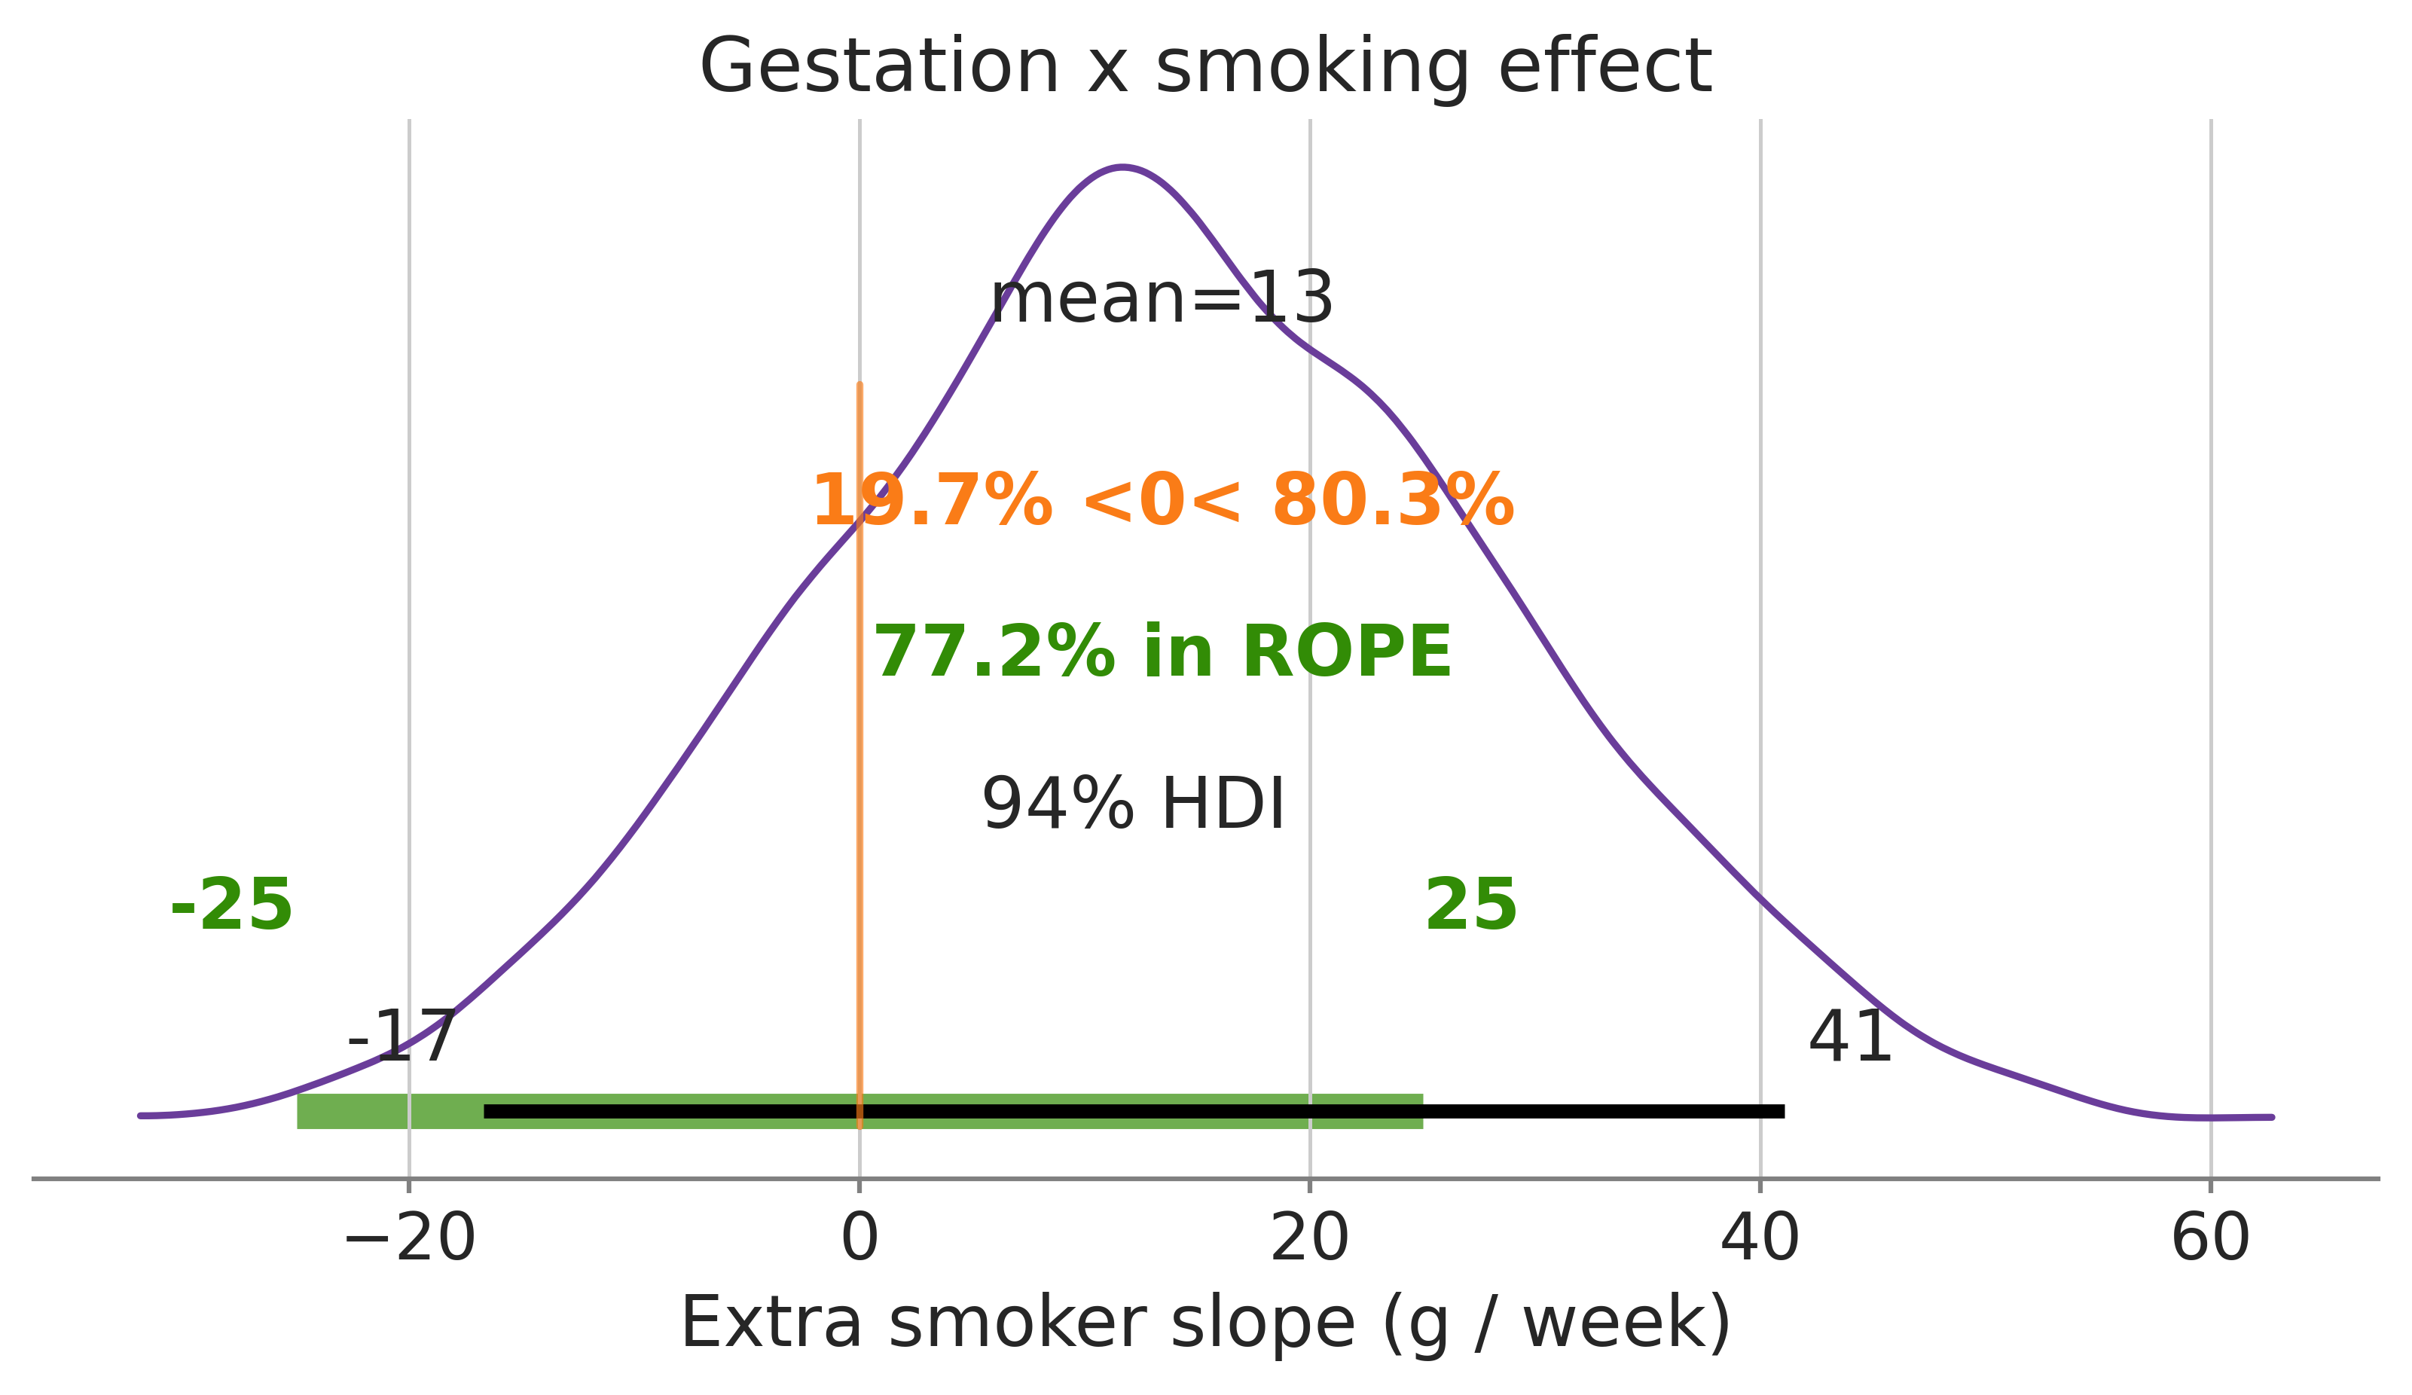
The central parameter of interest is the effect of smoking
A small effect in both leading models

Slide 64
Summarizing the smoking / birthweight analysis
For the model as a whole
All models have similar overall effect size
All models have similar predictive power
For the parameter of interest
Simple additive model gives tightest bounds
Interaction model has largest effect size but large uncertainty
Taken together
Across models there is a small but consistent effect of smoking
Acorss models there is no strong evidence for an interaction

Slide 65
10.7 Updated Bayesian workflow
Model comparison is one step in a larger analysis

Slide 66
Next time: complex data one last time!
Combining regression with hierarchical models!

